Slide 1
The Economics of a Gunpowder War on Britain
Jonathan Quang Period 3

Slide 2
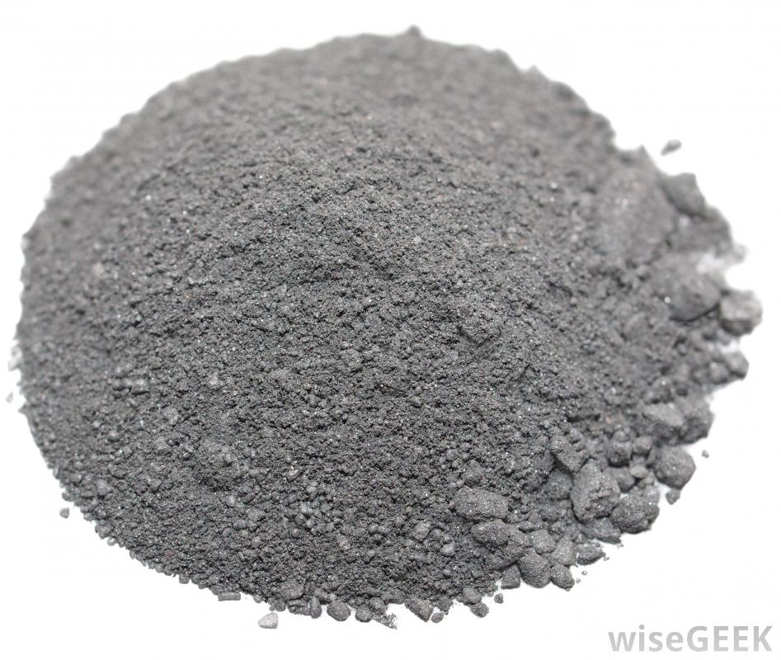
Aim: How can economics be used as a weapon in a gunpowder war?
Do Now: Discuss with your groups what you know about gunpowder before the invention of machine guns.

Slide 3
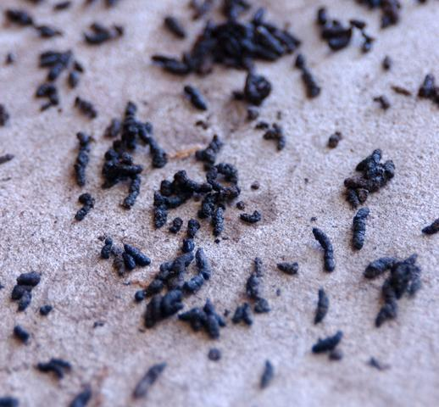
Where Does That Come From
Charcoal came from burning wood -Cheap 15%
Sulfur came from mines near volcanoes -A little less cheap 10%
Potassium Nitrate came from bat guano -Very Expensive 75%

Slide 4
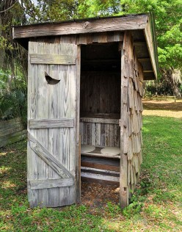
Potassium Nitrate ~US Civil War Era
Around the time of the US Civil War came a cheaper way to produce it.
Take urine and manure from outhouses, mix with ashes for a couple months, then dry it.

Slide 5
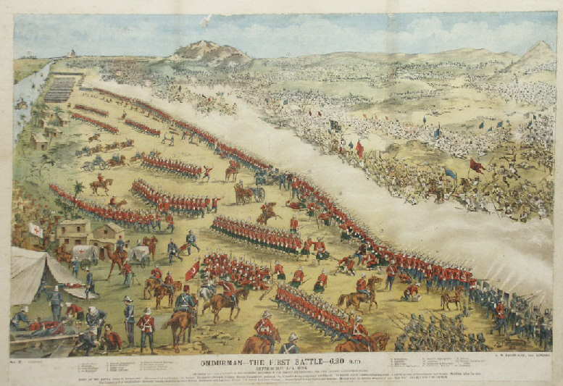
Battle of Omdurman

Slide 6
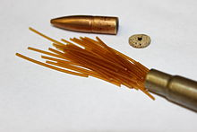
Britain Around WWI
Switches to CORDITE
Nitroglycerine, guncotton, and petroleum jelly with acetone as a solvent
Acetone supply low, very expensive

Slide 7
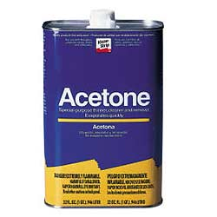
Acetone from Before to Mid World War I
Destructively Distilled from Wood
Americans and Austrians get rich from exporting wood
By 1914 Britain only had 3200 tonnes of acetone

Slide 8
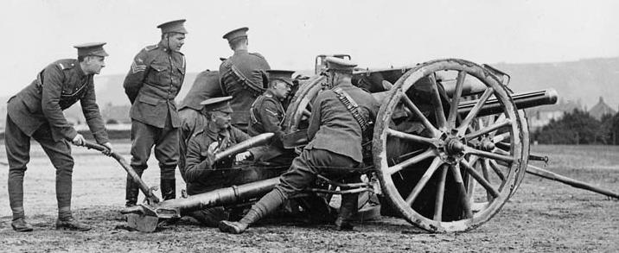
Not So Smart Choices
British military decided to switch to attacking with lots of HE shells
Shell Crisis of 1915
Britain starts Ministry of Munitions

Slide 9
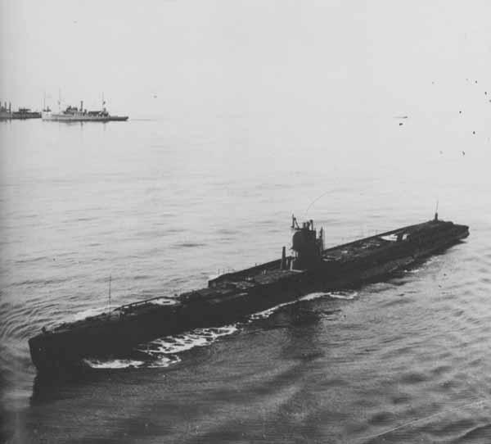
Acetone from Food
Chaim Weizmann discovers starch + specific bacteria = acetone
Britain previously got a lot of food from trade
Germany’s U-boats attack ships with food

Slide 10
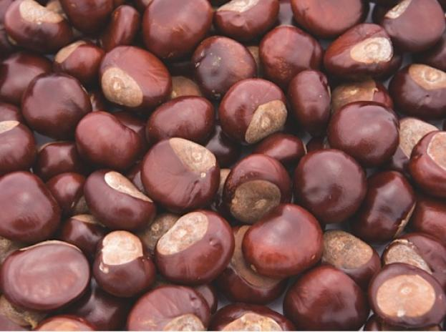
Conkers

Slide 11
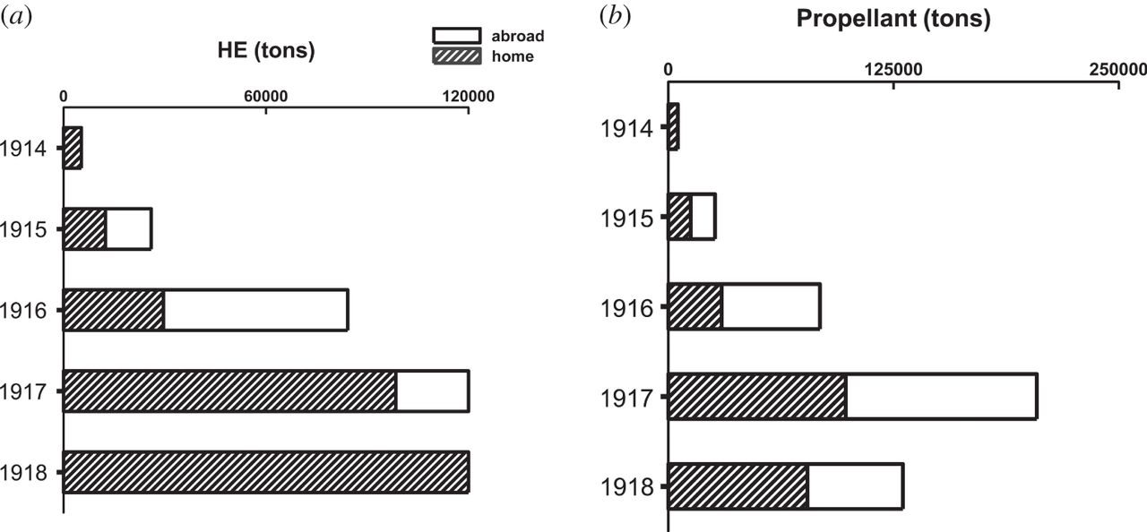
Britain solves shortage
Switches to Cordite RDB
Guncotton switched for weaker nitrocellulose
Single base rifle cartridges from USA

